Slide 1
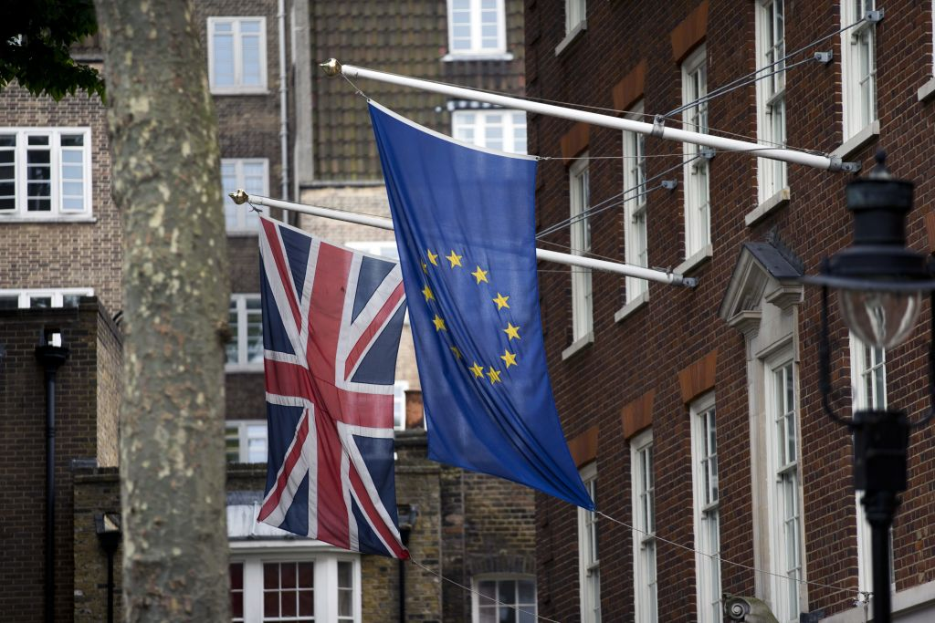


Preparing for Brexit
Considerations for the commercial cleaning industry
6th February 2018

Slide 2
The process ahead: the simple version
March Council
October Council
March 2019
Transitional Arrangements
Political Agreement on future framework
Drafting of Withdrawal
Treaty
EP Ratification
UK Parliamentary approval by statute
© Global Counsel 2018

Slide 3
The process ahead: the complicated version
2018
2019
Jan Feb Mar Apr May Jun Jul Aug Sep Oct Nov Dec Jan Feb Mar Apr May Jun
EU (Withdrawal) Bill
Jan - May
UK Parliament vote on Withdrawal Agreement
TBC
UK formally leaves EU
29 March
Trade Bill and
Taxation (Cross-Border Trade) Bill
Jan - Apr
Immigration Bill and other sectoral legislation (fisheries, agriculture)
TBC
Withdrawal Agreement and Implementation Bill
Oct - Dec
Proposed transition period
Apr onwards
UK
Data Protection Bill
Jan - Mar
Local elections
3 May
Budget
Nov/Dec
UK-EU27 negotiating rounds
Ongoing throughout 2018
General Affairs Council
(transition Directives)
29 Jan
European Council
(Decision on transition;
trade Guidelines)
22-23 Mar
European Council
28-29 Jun
European Council
18-19 Oct
European Council
13-14 Dec
Extraordinary EU27 Council (future of Europe discussion)
9 May
EU27
EU27 informal
23 Feb
EU27 informal
TBC
EU Parliament vote on Withdrawal Agreement
TBC
Italian election
4 Mar
Hungarian election
Apr/May
Swedish election
9 Sep
European ‘Spitzenkandidat’ process concludes
TBC
European elections
May/Jun
Bulgarian Presidency
H1 2018
Austrian Presidency
H2 2018
Romanian Presidency
H1 2019
© Global Counsel 2018

Slide 4

Changing rights to work
The right to work in the UK of EEA nationals is currently not constrained – Brexit is likely to change this.
The UK government broadly distinguishes between higher and lower skilled EEA workers, with a greater degree of change expected for the latter category.
A forthcoming Immigration Bill will give the UK government legal powers to limit immigration of EEA nationals, but will not decide on the number of migrants that will be permitted, nor the basis on which they can enter and work in the UK.
Independent advice on the UK’s future migration framework will be provided to the Home Secretary by the Migration Advisory Committee in September 2018. Firm decisions on the future migration framework are unlikely to be taken prior to this.
Questions for cleaning businesses
Have you assessed the number and status of EEA nationals in your existing workforce? Do they understand their current and future status?
Have you tested your growth plans against their dependence on a free flow of EEA nationals?
Are you across your exposure to immigration and visa changes in your supply chain?
Are you anticipating changes to EEA nationals’ status in your employment contracts?
© Global Counsel 2018

Slide 5



Changing rights to work: evolution over time
Guaranteed right to work?
Need to register?
Pay to
hire?
Limit on
Number?
EU member
Already in workforce
Arriving before transition
Left EU; transition
Arriving during transition
?
Fully left EU
Arriving after transition
?
© Global Counsel 2018

Slide 6


Changing rights to trade
Reasserting control over migration policy and regaining control over domestic regulation means leaving the regulatory perimeter of the EU and the jurisdiction of the ECJ.
No Brexit model is likely to preserve free circulation of goods between the UK and the EU.
Regaining control of the UK’s external tariffs means leaving the external tariff of the EU – and the customs union.
This makes a bilateral trade agreement the only viable mechanism for eliminating tariffs on UK trade with the EU and into the EU customs union.
However, it also creates scope in principle for the UK to offer concessions across its full market access schedule in future FTAs of its own.
‘Free movement of goods zone’
Common external tariff
Regulatory perimeter
EU
EEA Membership
Customs Union
© Global Counsel 2018

Slide 7





Changing rights to trade
At one end of a spectrum, a ‘Hard Brexit’ could see the UK subject to all of the EU’s standard tariffs on UK exports and could see the UK levy similar tariffs on EU exports to the UK.
The other option, an EU-UK FTA, could eliminate most of these tariffs.
However any model will see new processing and documentation requirements, including the possible need to prove the manufacture of an export in the UK (or EU) in order to benefit from tariff-free trade with the EU or UK.
The EU and the UK will probably maintain separate systems of product standards in most areas, although there may be a degree of mutual recognition.
Does a EU-made product meet UK product standards?
£
Customs processing
New documentation
Origin requirements?
Tariff to pay?
VAT to pay?
£
Does a UK-made product meet EU product standards?
© Global Counsel 2018

Slide 8
Issues checklist
 |  | EEA plus |  | Flexible participation |  | FTA plus |  | Hard Brexit
Goods trade |  | Full participation in single market for goods |  | Full participation in single market for goods |  | Tariff free market access; non-tariff barriers emerge |  | MFN tariffs; non-tariff barriers emerge
Services trade |  | Full participation in single market for services, but practical problems possible |  | Partial participation in single market for services; practical problems possible |  | Partial access through equivalence regimes or GATS terms |  | GATS terms only, limiting access without establishment
Sectoral regulation |  | UK adopts EU legislation; unclear whether UK would have meaningful influence |  | UK adopts relevant legislation; unclear whether meaningful influence |  | Separate regulation, but cooperation |  | Separate regulation, meaning dual regulation for exporting firms
State aid and competition policy |  | UK adopts EU policies and participates in EU system |  | Unclear, but some cooperation likely at a minimum |  | Separate rules, process; cooperation possible; divergent industrial policy |  | Separate rules and process; divergent industrial policy; scope for policy conflict
Data location and transfer rights |  | UK adopts EU policies and participates in EU system |  | Either participation in EU system or separate agreement negotiated |  | Data protection agreement required |  | Data protection agreement required; transition gap disruptive for business
Free movement |  | UK participates, with possible scope for an emergency brake |  | UK participates, with scope for emergency brake or other concessions |  | Rights for EU citizens living in UK; preferential treatment for EU workers |  | End to free movement for UK; controls on EU migration likely
Other horizontal policies |  | Environment, health & safety, consumer protection etc; but less influence |  | Depends on extent of participation in single market; less influence |  | Very limited |  | None
Flanking policies |  | Education, research and development, culture etc |  | To be negotiated; UK would want to participate in education, research |  | To be negotiated; UK would want to participate in education, research |  | Limited; may be negotiated subsequently
Money |  | Still large contribution |  | Significant, but lower contribution |  | Possibly a small, indirect contribution |  | No contribution
© Global Counsel 2018

Slide 9
The value of transition
The UK and the EU have agreed to negotiate a transitional framework to provide time for both sides to adapt to the UK’s exit and to negotiate and ratify a new framework agreement.
It is generally expected that this period will be around 2 years, and will probably involve the extension of the status quo for trade between the UK and the EU.
This period will provide an important window of opportunity for businesses to review supply chains and internal capabilities and prepare for change. It will also provide vital time for the UK authorities to adapt border protocols and other systems.
However, it needs to be borne in mind that this timetable is complex and demanding.
Q1 2018
The EU and the UK seek to agree terms for transitional arrangements.
The EU and the UK finalise the terms of the UK’s EU withdrawal
The UK ‘exits’ the EU, but remains bound by the EU acquis for a period of c2 years.
Trading conditions remain as they are now for this period.
The EU and the UK seek to negotiate and ratify a new FTA.
Transition to the new framework
Q3 2018
March 2019
Q1 2021
© Global Counsel 2018

Slide 10
Authors:
Leo Ringer, Head of UK, l.ringer@global-counsel.co.uk

