Slide 1

Becoming an Employer of Choice
for the New Generation
Prepared by: Chris Tarry & Jemma Redden
February 2018
Prepared for: ISSA

Slide 2

Agenda
Introduction - Access Generation CIC
What businesses are saying…
Current challenges
Our research findings
The strategic solution
Top takeaways to become an employer of choice

Slide 3
Introducing Access Generation CIC
Access Generation CIC is a social enterprise and our primary aim is to encourage businesses to employ inexperienced young people (16 to 24 year olds) by providing straightforward free practical guidance online at www.accessgeneration.co.uk
We help businesses build their own pool of talent and become an employer of choice for young people.

Slide 4
What businesses are saying...
Retention is a challenge
20-30% of process level workers are EU nationals
Recruitment is becoming difficult
Productivity is an issue

Slide 5
What businesses are saying...
“We have never had a problem with attraction and recruitment and never used agencies but we are now struggling”
“Young people don’t want to work in our industry”
“We can’t find people with the right skills”
“Where can we find young people?”
“We have used agencies but they don’t really work for us”

Slide 6

Current challenges?
Is the recruitment market tightening?
Are you concerned about the impact of Brexit on recruitment?
What strategy or risk mitigation are you employing?

Slide 7
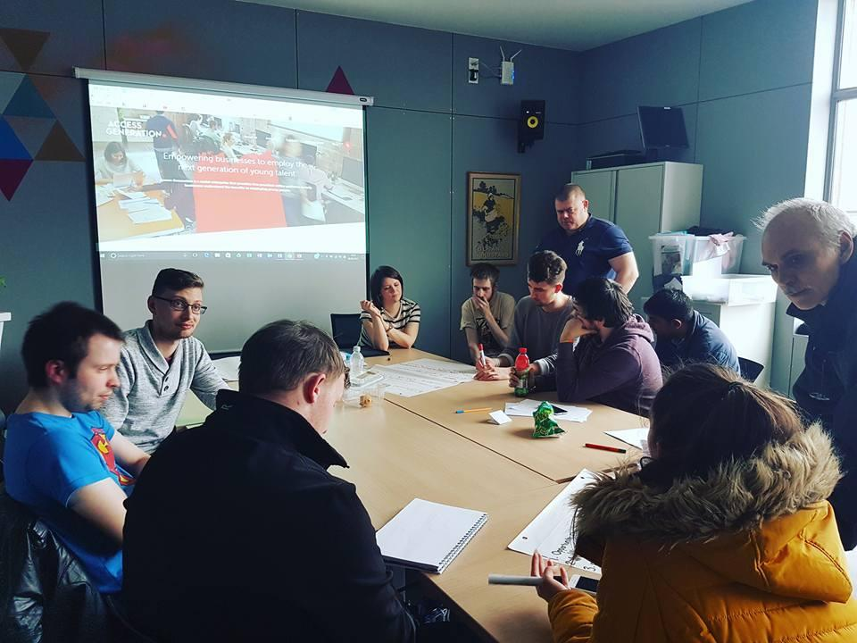




Young people led research with the Prince’s Trust
Researching online employment accessibility based on criteria set by and assessed by young people.
80% of young people will access a company’s website to decide if they are interested in working for them.
200 companies researched in three industry sectors
Notes:
We wanted to challenge our own assumptions
There are many blogs from thought leaders who say millennials want the Google type office or the Kardashian lifestyle
We went back to source – to young people
We ran focus groups with university students and young people being supported by initiatives including Prince’s Trust
First thing we found out is that 80% of young people will access a companies website regardless of where they first saw a job posting

Slide 8

Contents
Only 25% of businesses had an entry point for young people to gain employment
“We just want someone to give us a chance to work”

Slide 9

Contents
50% of businesses had a very poor or no job section on their website
“I couldn’t tell from the website what was expected of me in terms of the job or even how to apply”

Slide 10

Contents
Four out of five businesses failed to promote their employer brand
“Businesses all say the same thing, like they all invest in their people. But I want to know what that means and how it will help me get to the next level in my career”

Slide 11

Contents
Are you confident that your company is represented online the way you would want?
Who is accountable for the quality of your job or careers section of your website?
Bullet example
Bullet example
Bullet example
Bullet example

Slide 12
The strategic solution
Engagement
Involve employees in problem solving
Attraction
Promote your industry sector
Promote your purpose and role in society
Innovation
Use of technology
New ways of working
Progression
Investing in training and development

Slide 13
Contents
Top tips to become an employer of choice
Think local - even if you are multinational or national you need to think local
Treat candidates as customers - are there any unnecessary barriers in the way?
Promote your purpose - what do you do for society?
Bullet example
Bullet example
Bullet example
Bullet example

Slide 14
Contents
Would you like to know how accessible your company is for the next generation?
We can offer you the following:
Provide an employer attractiveness index score (based on criteria set by 100 young people)
Provide an assessment of how accessible your business is for young people
Training workshops on what you need to do and what online content is required to attract young people to your business
Contact information
www.accessgeneration.co.uk
Chris Tarry - 07976403301 chris.tarry@accessgeneration.co.uk
Jemma Redden - 07709063458 jemma.redden@accessgeneration.co.uk
Bullet example
Bullet example
Bullet example
Bullet example

Slide 15
Any questions?
Thank you for your time

