Slide 1
ISSA NETWORKING EVENT MALMÖ 5th June 2018
International Management – Leading and working
with people from different cultures
Harri Piiparinen

Slide 2
ISSA NETWORKING EVENT MALMÖ 5th June 2018
This 20 – 30 minutes is not based on any academical research
Focus is mostly in verbal communication
Includes few slides to prepare my journey to next case
Sources I am referring to are article by PhD Carol Kinsey Goman, USA 2011 ” Communicating Across Cultures”, some articles from Business Today, Social Talent, Silent language and beyond cultures + colleagues during the years…

Slide 3



International Management – Leading and working with people from different cultures
Starting point – Finland
70’s – 80’s
90’s….

Slide 4
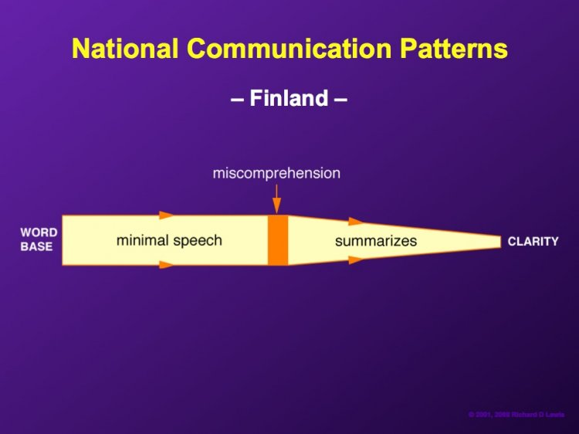
International Management – Leading and working with people from different cultures
Finnish people and communication style from others point of view
” Small talk” totally unknown skill in Finland…

Slide 5
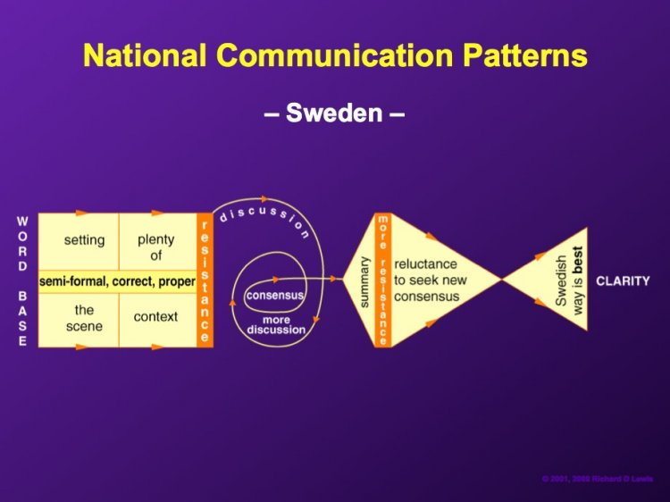
International Management – Leading and working with people from different cultures
Next stop Sweden + Nordic …

Slide 6
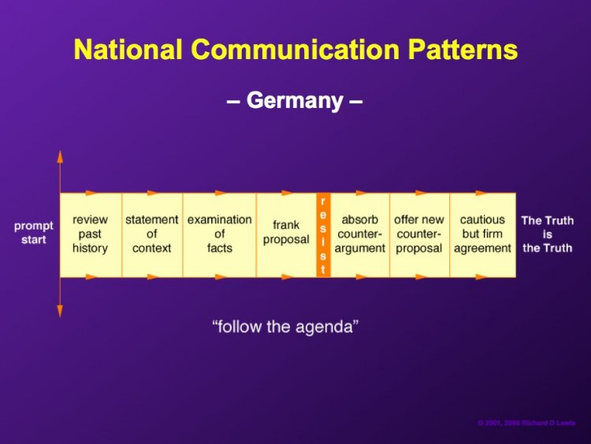
International Management – Leading and working with people from different cultures
Next Step Germany and Europe

Slide 7
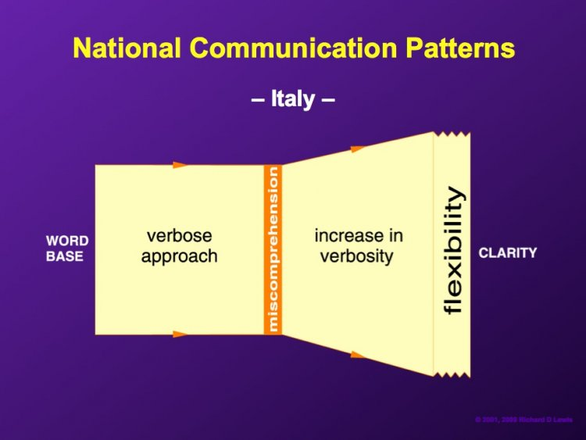
International Management – Leading and working with people from different cultures
International project teams, Paneuropian launches… Time to prepare yourself better

Slide 8
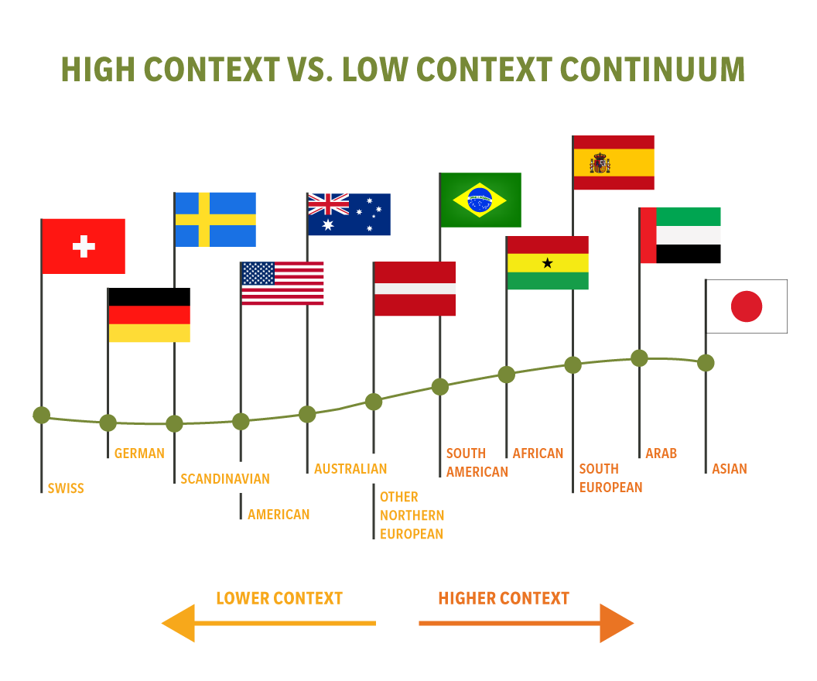
“High-context” cultures rely heavily on nonverbal communication, using elements such as the closeness of their relationships, strict social hierarchies and deep cultural knowledge to convey meaning.
Disagreements are personally threatening. It is important to solve conflict immediately or avoid it completely in order for work to continue.
“Low-context”cultures depend largely on words themselves. Communication tends to be more direct, relationships tend to begin and end quickly, and hierarchies are more relaxed. Disagreements are depersonalized. Conflicts do not have to be resolved immediately for work to continue. When solutions are found, they tend to be rationally based.
Source / Social talent

Slide 9
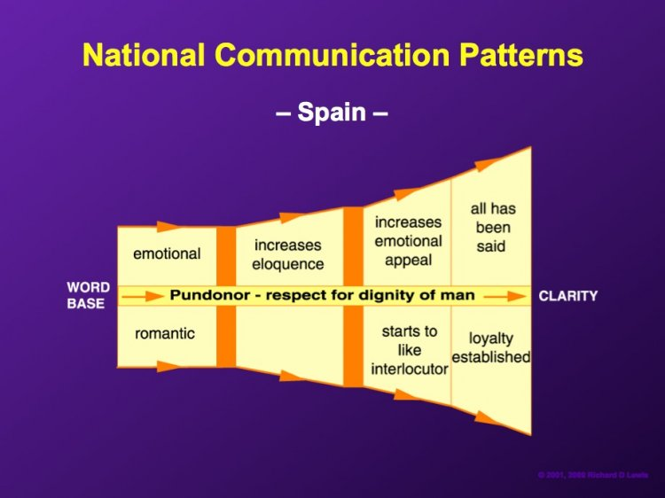
International Management – Leading and working with people from different cultures
Back to Nordic… and having a Spanish boss☺

Slide 10
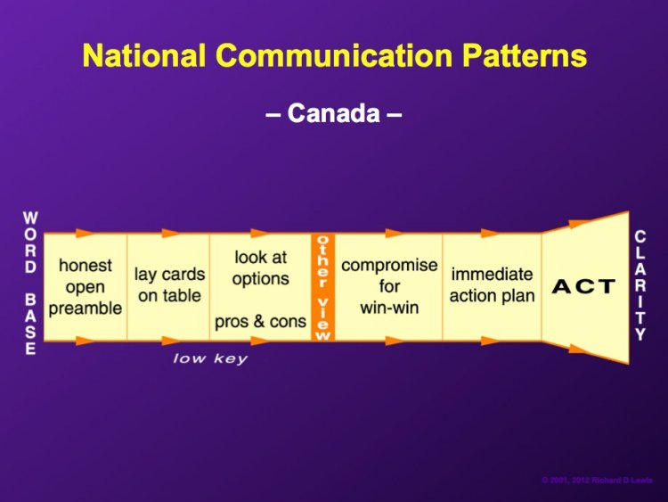
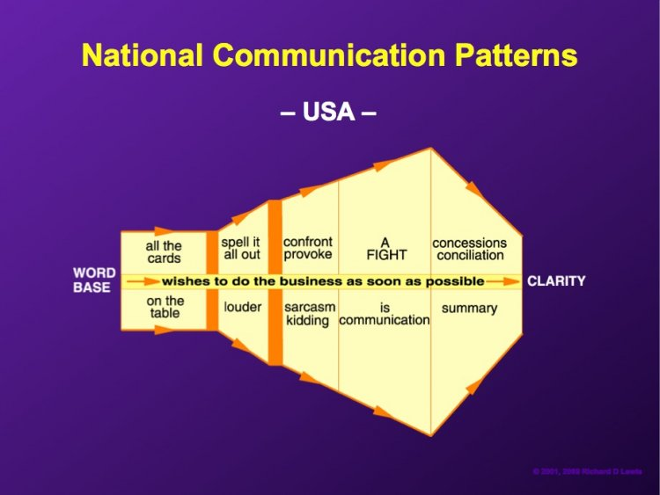
International Management – Leading and working with people from different cultures
Over the Ocean… Better than ever pre-prepared
Role of a boss
Industry specialities
Shop floor people
Things always worse…
Mexico

Slide 11
International Management – Leading and working with people from different cultures
It is important to note that no culture is “better” than another; communication styles simply convey differences, rather than superiority.
"We are all individuals, and no two people belonging to the same culture are guaranteed to respond in exactly the same way”.
“The most important thing in communication is hearing what isn’t said.”
-Peter F. Drucker

